Slide 1
Presentation Outline
Course Certificate
Introduction
Objectives
System Architecture / Ideation Map
Module Implementation
Application Snapshots
Results and Discussions
Conclusion & Future work
References

Slide 2
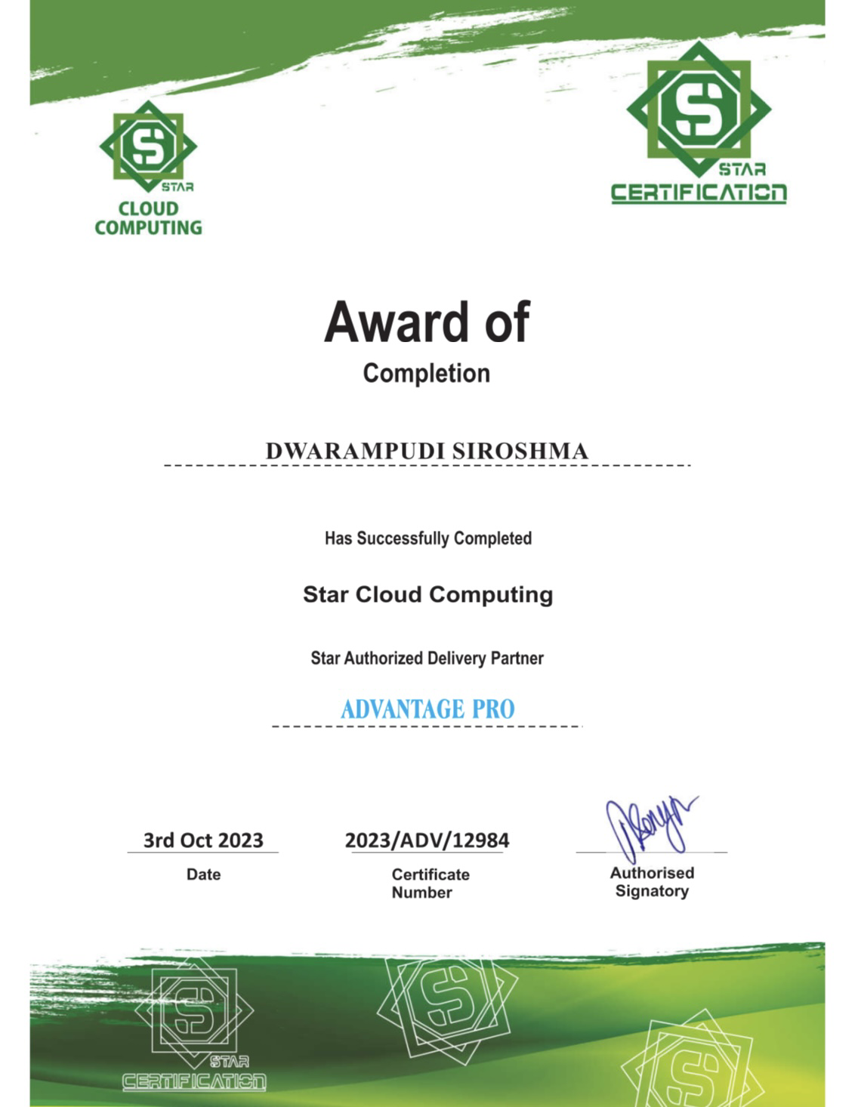
Course Certificate

Slide 3
Introduction
An Application Load Balancer functions at the application layer, the seventh layer of the Open Systems Interconnection (OSI) model. After the load balancer receives a request, it evaluates the listener rules in priority order to determine which rule to apply, and then selects a target from the target group for the rule action using the round robin routing algorithm. Note that you can configure listener rules to route requests to different target groups based on the content of the application traffic. Routing is performed independently for each target group, even when a target is registered with multiple target groups.

Slide 4
Objectives
High Availability: ALBs are designed to ensure that your application remains available even if individual instances or components fail. By distributing traffic across multiple healthy targets, they help reduce the risk of downtime due to hardware failures or other issues.
Load Distribution: ALBs evenly distribute incoming traffic among multiple targets based on configured rules and algorithms. This prevents overloading of individual instances and ensures optimal resource utilization.
Scaling: ALBs play a crucial role in auto-scaling scenarios. As your application traffic increases, you can add more targets (e.g., EC2 instances) to your load balancer, and it will automatically route traffic to the new instances.
In summary, Application Load Balancers are a critical component of modern application architectures, providing high availability, scalability, security, and flexibility for routing and managing incoming traffic to your applications and services.

Slide 5
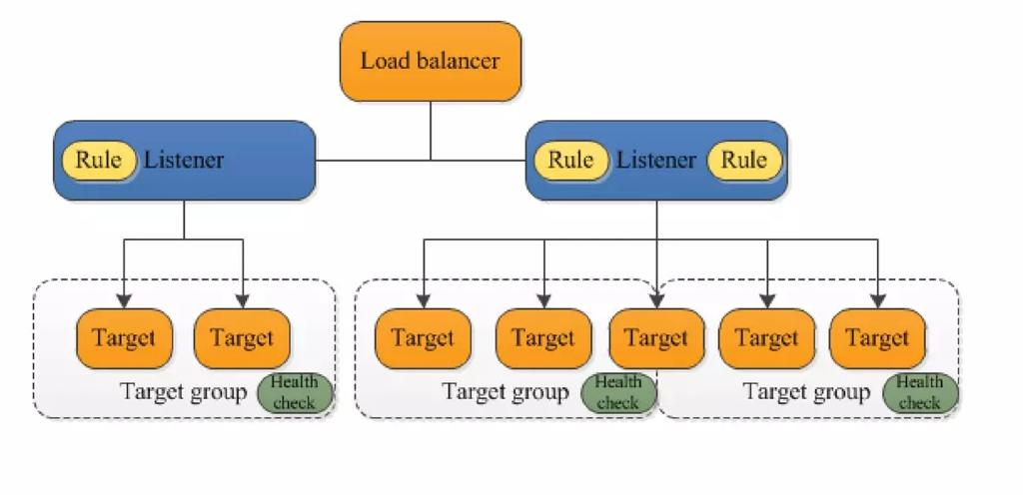
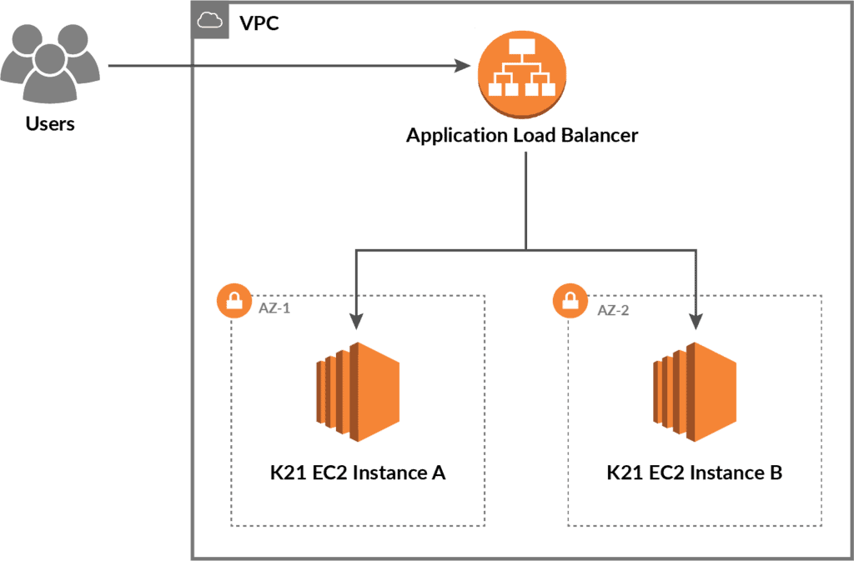
System Architecture/ Ideation Map
11 November 2021
Department of CSE
5

Slide 6
Module Implementation
Step 1: Sign in to Your AWS Account- Log in to your AWS Management Console.
Step 2: Navigate to EC2 From the AWS Console, navigate to the EC2 service.
Step 3: Create Target Groups- Create one or more target groups to define how traffic should be routed to your instances. Define the target group's protocol (HTTP/HTTPS) and port.
Step 4: Register Targets- Register the instances (or other resources) that you want to distribute traffic to with your target groups. These are the backend servers that will handle incoming requests.
Step 5: Create an Application Load Balancer- Create a new Application Load Balancer. Configure the load balancer settings, including the listeners (HTTP/HTTPS), security groups, and subnets.
Step 6: Configure Listener Rules- Define listener rules to determine how requests should be routed based on criteria like URL paths, hostnames, or headers. Listener rules help route traffic to the appropriate target groups.

Slide 7
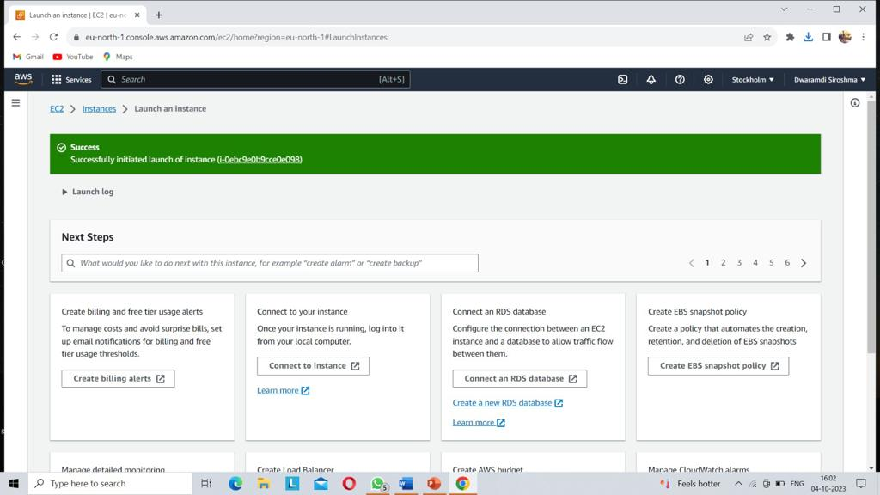
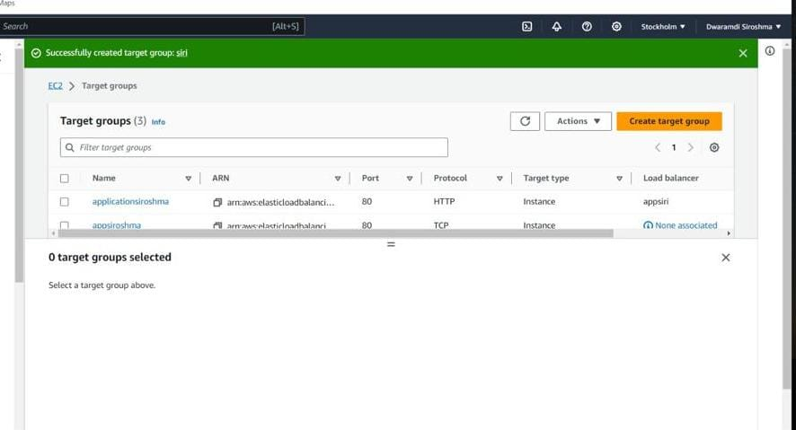
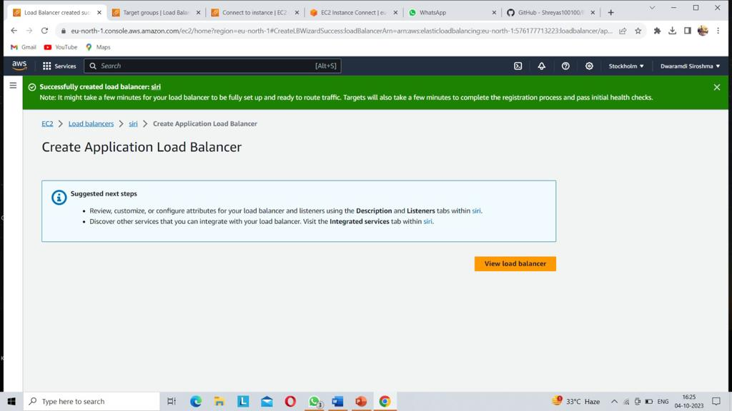
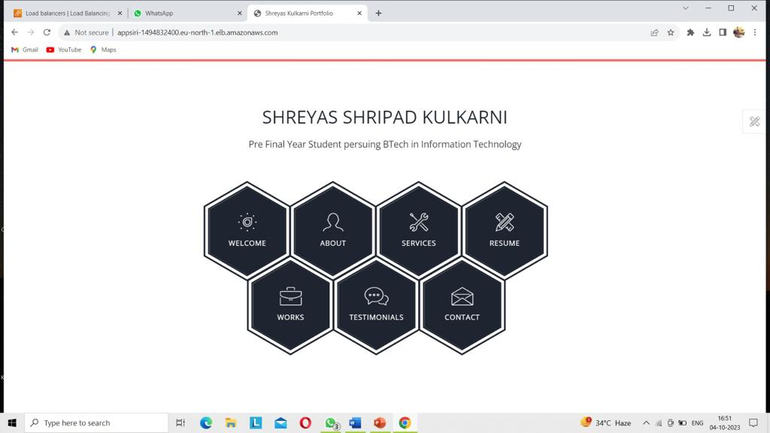
Sample Snapshot
Fig 2: creation of target group
Fig 1: creation of instances
Fig 3: creation of application load balancer
Fig 4: successfully connected web application with ALB

Slide 8
RESULTS AND DISCUSSION
RESULTS :
Load balancing directs and controls internet traffic between the application servers and their visitors or clients. As a result, it improves an application's availability, scalability, security, and performance.
DISCUSSIONS :
Cost-Effectiveness: Discuss the cost-effectiveness of using an ALB. It can optimize resource utilization by directing traffic where it's needed, potentially reducing the number of instances required.
SSL/TLS Offloading :Explain the benefits of SSL/TLS offloading, where the ALB handles encryption and decryption of traffic. This can reduce the computational load on backend instances.
Remember that the discussion will largely depend on your specific use case, goals, and the insights you've gained from using the ALB in your application infrastructure. It's an opportunity to reflect on the effectiveness of your setup and identify areas for further improvement.

Slide 9
IMPLEMENTATION MODULES
Path-Based Routing: Configure path-based routing rules to direct incoming requests to different backend services or applications based on the URL path. This is useful for hosting multiple services under the same domain.
SSL/TLS Termination: Implement SSL/TLS termination to offload encryption and decryption tasks from your backend servers. This module allows the ALB to handle SSL/TLS certificates and secure traffic between clients and the ALB.
Host-Based Routing: Implement host-based routing rules to route traffic to different backend services based on the hostname in the request. This enables you to host multiple websites or applications on the same ALB, each with its own domain or subdomai
Auto Scaling Integration: Integrate the ALB with auto-scaling groups to automatically add or remove backend instances based on traffic demand.
The specific implementation of these modules will depend on the cloud provider you are using (e.g., AWS, Azure, GCP) and the capabilities provided by the ALB service. Always refer to the documentation of your chosen cloud provider for detailed instructions on how to implement these modules within your ALB.

Slide 10
Conclusion
In conclusion, an Application Load Balancer (ALB) is a crucial component in modern web application infrastructure. Its primary role is to efficiently distribute incoming traffic across multiple backend resources, ensuring high availability, scalability, and optimal performance.
ALBs offer advanced routing capabilities, SSL/TLS termination, security features, and monitoring tools, making them indispensable for building resilient and responsive web applications. ALBs abstract away the complexities of managing hardware and networking, allowing developers and administrators to focus on configuring routing rules and ensuring backend resources are properly registered. Cloud providers, such as AWS, manage the underlying infrastructure, scaling, and maintenance of ALBs.
Whether in microservices architectures, auto-scaling environments, or for handling real-time applications, ALBs play a vital role in maintaining a seamless user experience. Their ability to adapt to changing traffic loads and their integration with security measures make them a cornerstone in delivering reliable and secure web services. In a world where uptime and responsiveness are critical, ALBs are a key tool for ensuring the success of web applications and services.

Slide 11
References
1] A. S. Hote, "A Review on Load Balancing in Cloud Computing," International Journal of Computer Applications, vol. 107, no. 1, pp. 10-16, 2014.
[2] Amazon Web Services, "Elastic Load Balancing," AWS Documentation, https://aws.amazon.com/elasticloadbalancing/, Accessed September 2021.
[3] Y. Zhang, H. Zhang, and L. Sun, "Research on Load Balancing Algorithms in Cloud Computing," 2012 Second International Conference on Cloud and Green Computing, Xiangtan, China, 2012, pp. 42-45.
[4] L. Xue and L. Jie, "An Effective Load Balancing Algorithm for Cloud Computing," 2010 International Conference on Computational Intelligence and Software Engineering, Wuhan, China, 2010, pp. 1-3.
[5] M. Pathan and I. Yaqoob, "Load Balancing in Cloud Computing: A Review," in Advances in Computing and Communications, A. Abraham, V. Snášel, and A. Krömer, Eds. Berlin, Heidelberg: Springer, 2012, pp. 1-10.
[6] Amazon Web Services, "What Is AWS Web Application Firewall?" AWS Documentation, https://aws.amazon.com/waf/, Accessed September 2021.
[7] Amazon Web Services, "Elastic Load Balancing Integration with Other AWS Services," AWS Documentation, https://aws.amazon.com/elasticloadbalancing/features/integration/, Accessed September 2021.
[8] Amazon Web Services, "What Is Elastic Load Balancing?" AWS Documentation, https://aws.amazon.com/elasticloadbalancing/what-is-elastic-load-balancing/, Accessed September 2021.

Slide 12


